Slide 1
Capstone Project 3 ‘Predicting Bitcoin Price’
SPRINGBOARD – DSC
By Igor Verevkin
August 2021

Slide 2
Problem Identification
BITCOIN
First and largest cryptocurrency
$40,000 per 1 BTC
$787 billions total market capitalization
Extremely volatile
GOAL
Build predictive models using time series forecasting algorithms
Predict Bitcoin price for one month

Slide 3
Data Acquisition
SOURCE
CoinGecko cryptocurrency exchange
DATA WRANGLING
Dataset
Observations: Bitcoin’s daily performance from April 2018
Exploratory Feature: Date
Target Feature: Bitcoin’s price
No missing values

Slide 4
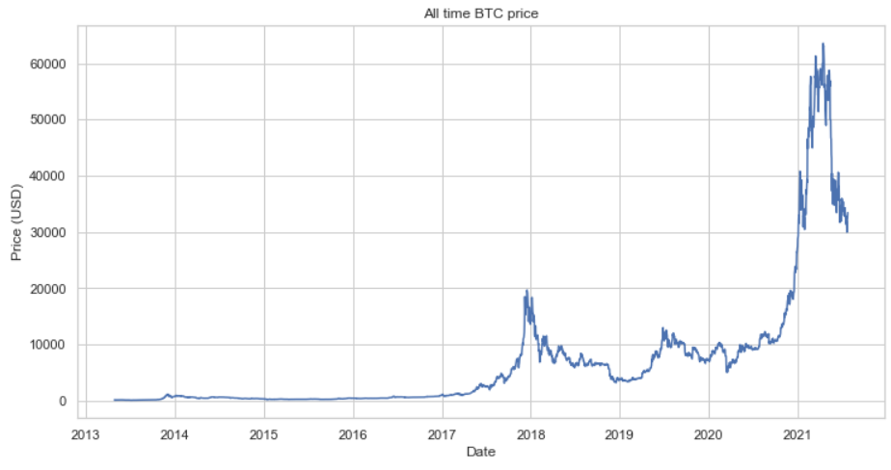
Bitcoin’s price chart 2013-2021

Slide 5
Exploratory Data Analysis
QUESTIONS
Feature-to-target correlation?
Is time series a random walk?
Is time series stationary?
Is time series autocorrelated?

Slide 6
Random walk
Random Walk - mathematical object, known as a stochastic or random process, that describes a path that consists of a succession of random steps on some mathematical space such as the integers.
In other words, we would like to find out if the price is random or not, because if it is indeed random then there is no way we can predict it.

Slide 7
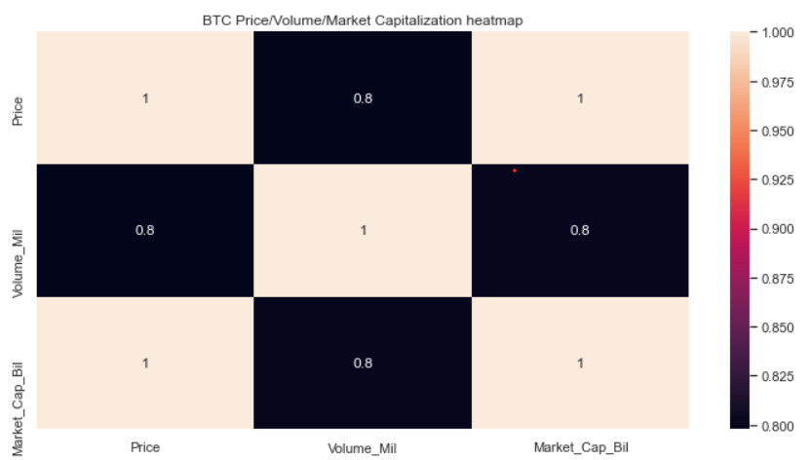
Feature correlation

Slide 8
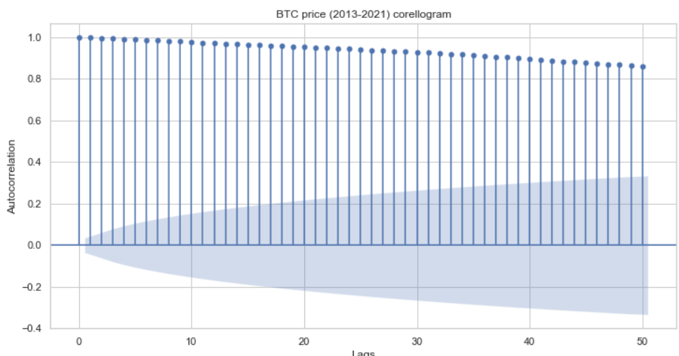

autocorrelation

Slide 9
Hypothesis testing
Null hypothesis: Non-Stationarity exists in BTC Price
Alternative hypothesis: Stationarity exists in BTC Price
AUGMENTED DICKEY-FULLER TEST
Helps to test if the process is stationary
The more negative the ADF statistic, the more confidently we can reject Null hypothesis

Slide 10

AUGMENTED DICKEY-FULLER Test
P-value is very high
Can not confidently reject null hypothesis
BTC price is NOT stationary

Slide 11
Baseline Modeling
Problem – time series forecasting (regression)
Baseline model – ARIMA
ARIMA order derived from ACF, PACF and differentiation
Performance metric – Mean Absolute Percentage Error (MAPE)
Goal – minimize MAPE

Slide 12
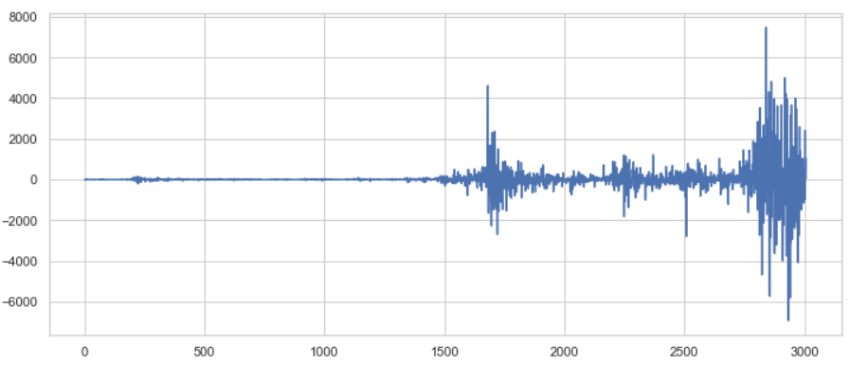
DIFFERENCING
DIFFERENCED BTC PRICE (order = 1)

Slide 13
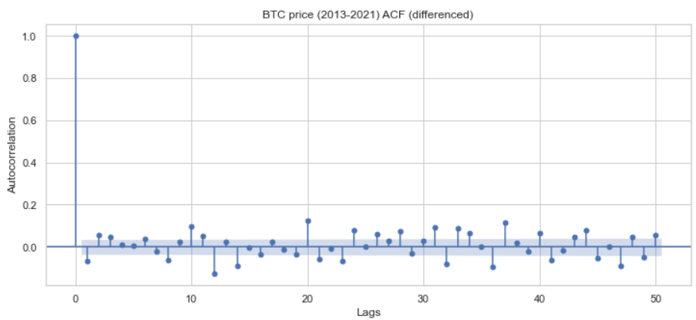
ACF PLOT

Slide 14
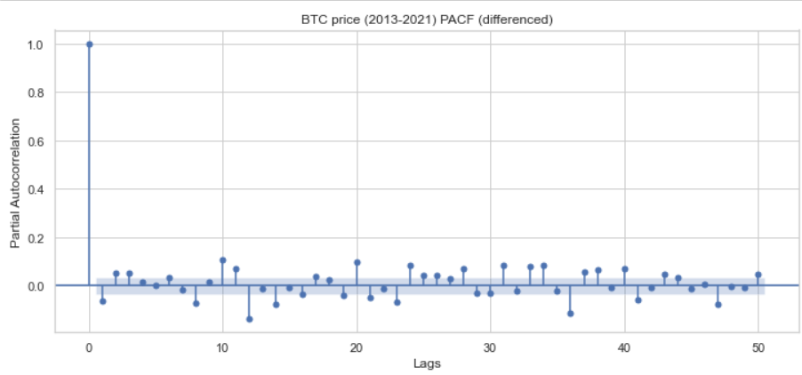
PACF PLOT

Slide 15
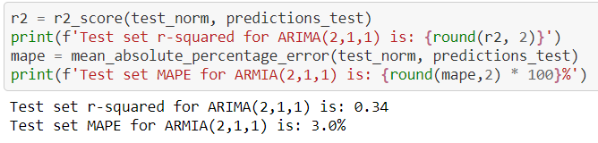
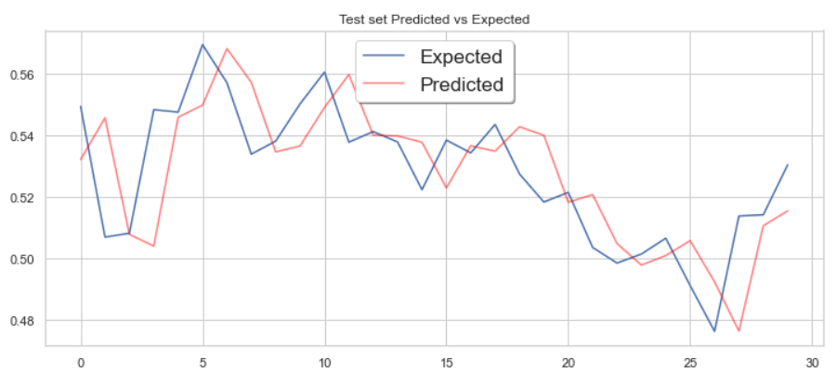
ARIMA (2,1,1)

Slide 16
extended modeling
GOAL
Build additional models
Compare their performance with baseline model
MODELS
Exponential Smoothing
Facebook Prophet
PyCaret

Slide 17
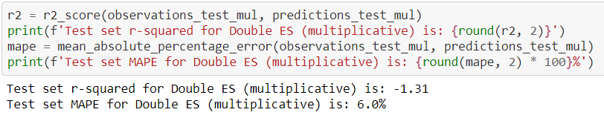
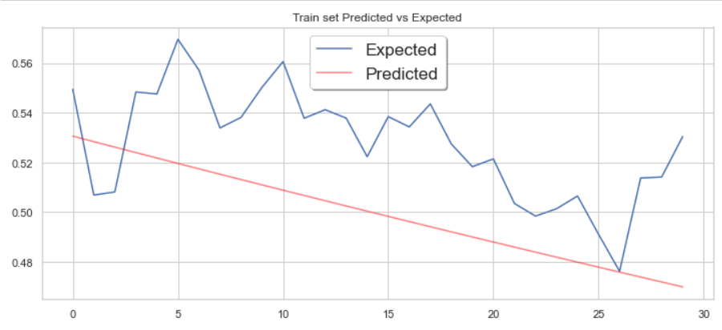
Exponential smoothing (not tuned)

Slide 18
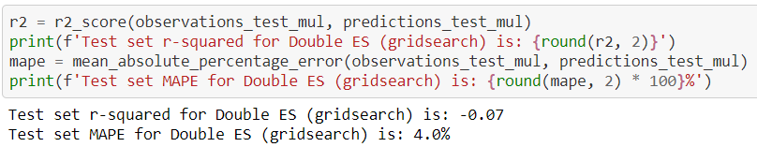
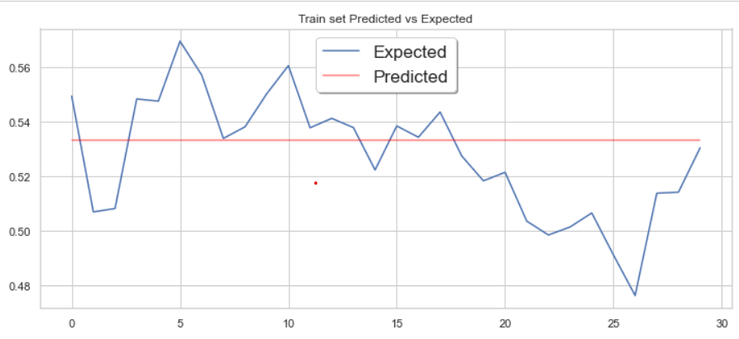
Exponential smoothing (tuned)

Slide 19
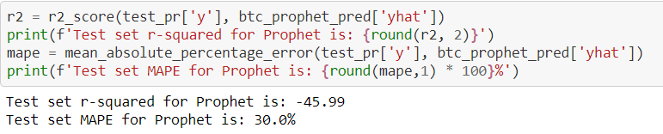
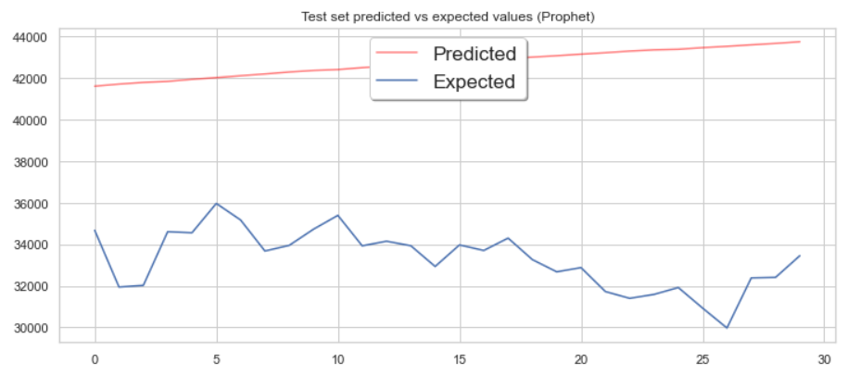
Facebook prophet (not tuned)

Slide 20
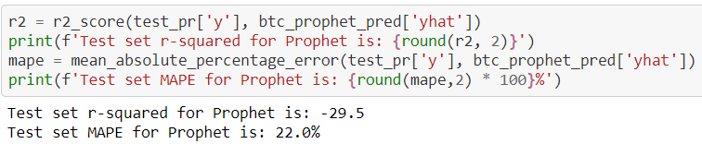
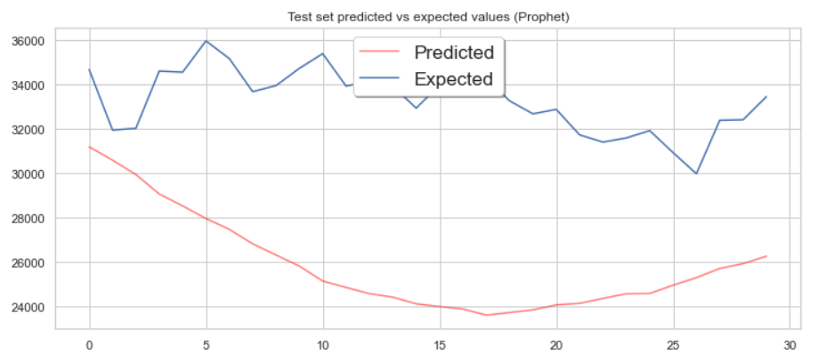
Facebook prophet (tuned)

Slide 21

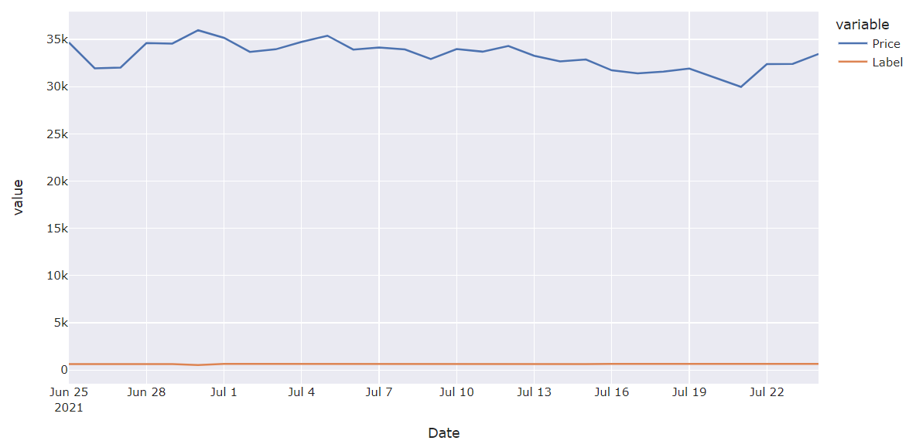
Pycaret passive aggressive regressor (not tuned)

Slide 22
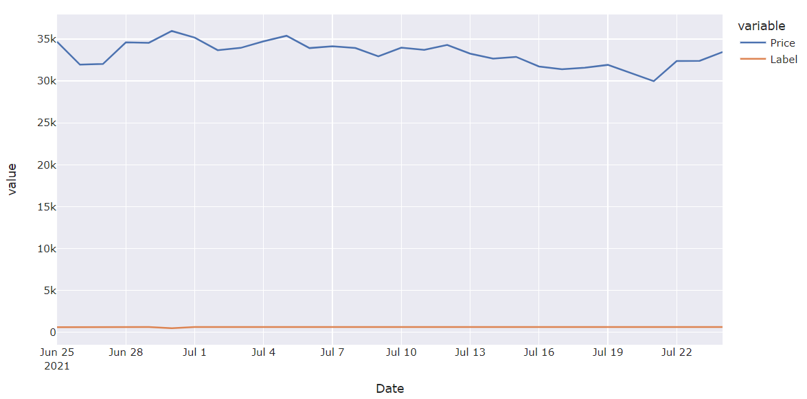
Pycaret passive aggressive regressor (tuned)

Slide 23
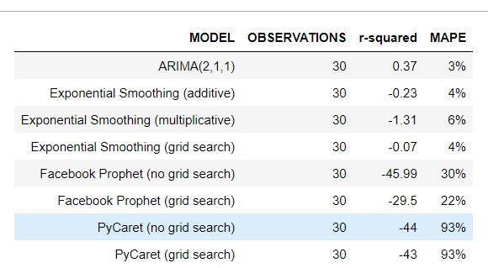
Modeling results
ARIMA(2,1,1) and Exponential Smoothing showed low MAPE
Only ARIMA(2,1,1) actually captured the data structure

Slide 24
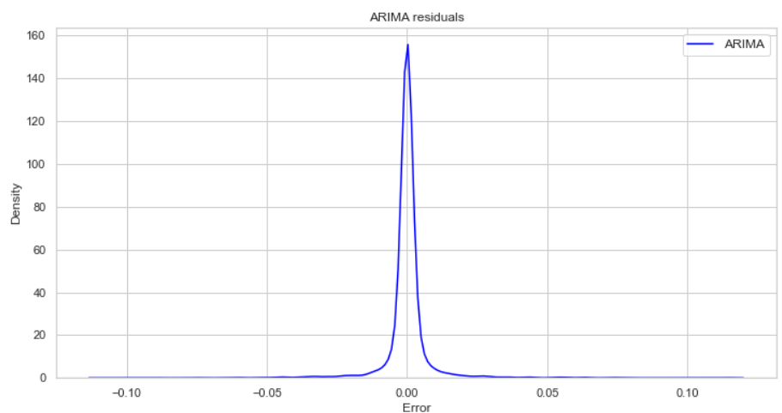
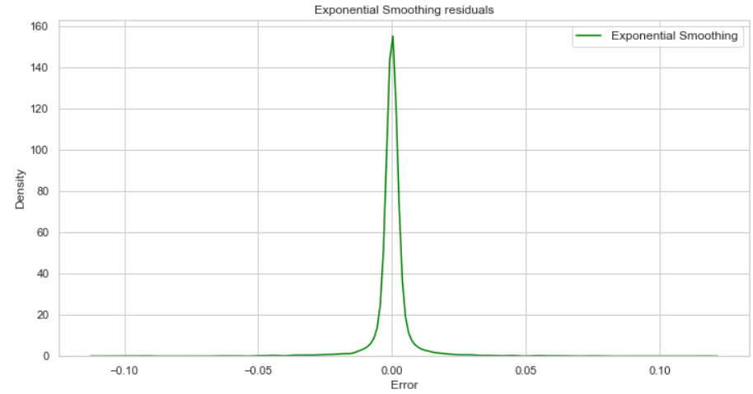
RESIDUALS PLOTS (ARIMA and exponential smoothing)

Slide 25
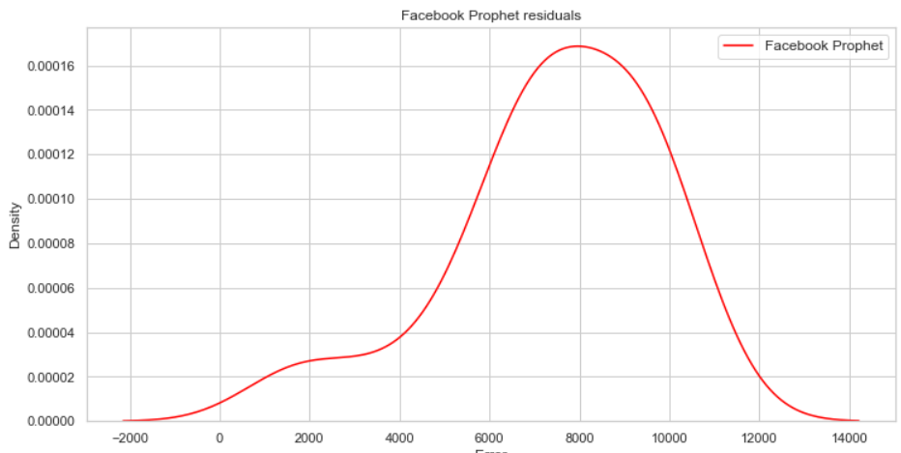
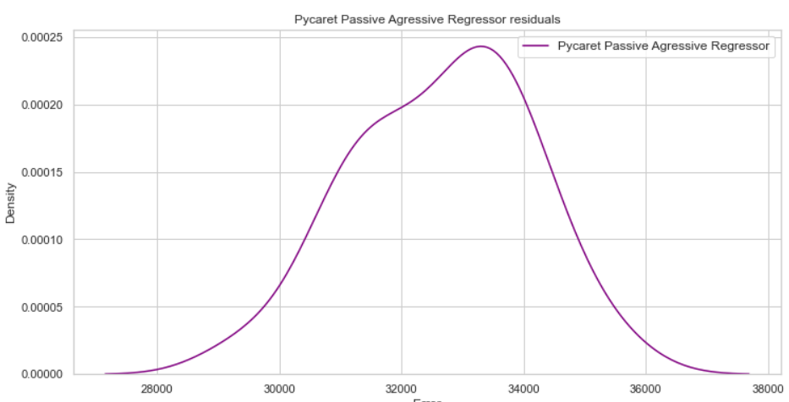
RESIDUALS PLOTS (PROPHET and pycaret)

Slide 26
Conclusions
ARIMA(2,1,1) showed low MAPE and accurately captured the data structure
Exponential Smoothing showed low MAPE but failed to accurately capture the data structure
Both Prophet and PyCaret showed high MAPE and failed to accurately capture the data structure

Slide 27
Future work
Apply neural networks
Perform sentiment analysis of bitcoin-related social media accounts

Slide 28
recommendations
Use ARIMA (2,1,1) for production implementation
Be cautious since no statistical model can predict human psychology

Slide 29
USEFUL LINKS
MAPE - https://en.wikipedia.org/wiki/Mean_absolute_percentage_error
Random Walk - https://en.wikipedia.org/wiki/Random_walk
Autocorrelation - https://en.wikipedia.org/wiki/Autocorrelation
Partial Autocorrelation - https://en.wikipedia.org/wiki/Partial_autocorrelation_function
Stationarity - https://en.wikipedia.org/wiki/Stationary_process
Hypothesis testing - https://en.wikipedia.org/wiki/Statistical_hypothesis_testing

Slide 30
USEFUL LINKS
ARIMA - https://www.statsmodels.org/stable/generated/statsmodels.tsa.arima_model.ARIMA.html
Exponential Smoothing - https://www.statsmodels.org/stable/examples/notebooks/generated/exponential_smoothing.html
Facebook Prophet - https://facebook.github.io/prophet/
PyCaret - https://pycaret.org/

